Slide 1

Problem Solving
Task 3
Roqaya Abdallah

Slide 2

The three approach for Problem Solving in Data Analysis:
DMAIC
PDCA
RCA

Slide 3
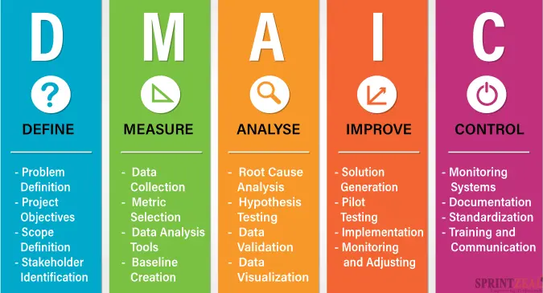
DMAIC

Slide 4

Example: Reducing Patient Wait Times in an Emergency Department
Define: the long patient wait time in an emergency department. The goal is to reduce the average wait time from 2 hours to 30 minutes in six months.
Measure: Ask the patient about their wait time and any necessary medical attention and get data from them. Follow the patient from the time of his arrival to the physician and get treated. Make a record of the number of nurses, doctors on staff, and peak hours.

Slide 5
Analyze: analyze the data to determine the reasons affected on wait time. The analysis show that the longest wait time occurs in the peak time. The patient registration and the scheduling of staff don’t align well with this time
Improve: implement changes to have the best wait time. As create a fast-track System for patients with minor issue that can be finished quickly. Make fast and easy registration by provide more stations and simplify the paperwork to improve the triage process. Rearrange employee schedules for more accessible employee in peak time.
Control: ensure the improvements are implemented and it solved the problem “ reduce the patient wait time”. Take a survey from patients about improve the problem occurred or not. Gather patient feedback to identify any new issues promptly.

Slide 6
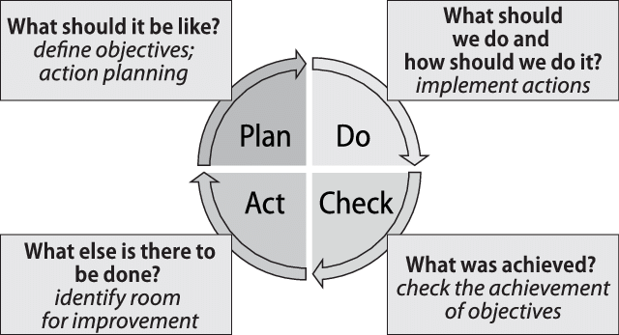
PDCA

Slide 7
Example: Reducing Medication Errors in a Hospital
Plan: identify the problem of "medication errors in a hospital." . And the goal is to reduce the medication errors to a minor number. collect data about that issue from nursing staff and patients. Analyze this data and then create solutions like patient wristbands and barcode medication systems to ensure the correct medication is given to the right patient at the correct time.
Do: implement the plan. Create the barcode system and the patient's wristband in the smallest section of the hospital for one month. Train the nurses on how to use them.
Check: check the achievement of the solution. compare the medication error percentage before and after implementing the solutions. Take feedback from patients and nurses about the solutions and advice to improve them more.
Act: if the wristband and the barcode system solve the problem and reduce the medication error percentage, implement them within the hospital on a large scale. If there are issues, adjust the system or training processes and run through the PDCA cycle again.

Slide 8

Identify the problem.
Collect data.
Analyze data.
Identify root causes.
Develop solutions.
Implement and monitor.

Slide 9

Example: RCA for Miscommunication of Patient Allergies
Identify the Problem: Patient allergies are sometimes not communicated effectively, leading to adverse reactions.
Collect data: gathering data such as allergies incidents report, patient review, interview with hospital staff and review of hospital policies and procedures.
Analyze Data: analyze the data to identify the pattern or possible causal factor.
Identify root causes: for discover the root causes , we can use the fishbone or five whys diagram.

Slide 10

I use the “five whys”:
Why 1: Why was the patient given a medication they are allergic to? Answer: Because the healthcare provider administering the medication did not know about the patient’s allergy.
Why 2: Why did the healthcare provider not know about the patient’s allergy? Answer: Because the allergy information was not prominently displayed in the patient's chart.
Why 3: Why was the allergy information not prominently displayed in the patient’s chart? Answer: Because the electronic health record (EHR) system did not have a standardized, easily visible section for allergies.
Why 4: Why did the EHR system not have a standardized, easily visible section for allergies? Answer: Because the hospital’s IT system is outdated and has not been upgraded to include this feature.
Why 5: Why has the hospital's IT system not been upgraded? Answer: Due to budget constraints and prioritization of other IT projects.

Slide 11

Develop solutions: propose solutions to solve the root causes such as its system update , training the staff to asking about allergies during patient’s records.
Implement and monitor:
Implementation:
Ensure that all proposed solutions are implemented according to the action plan.
Monitor the effectiveness of the solutions through regular audits and feedback sessions.
Evaluation:
Track the number of incidents related to allergy miscommunication before and after implementing the solutions.
Gather feedback from healthcare providers on the new system and training effectiveness.
Adjust the action plan based on ongoing evaluations to continuously improve the process.

